Slide 1
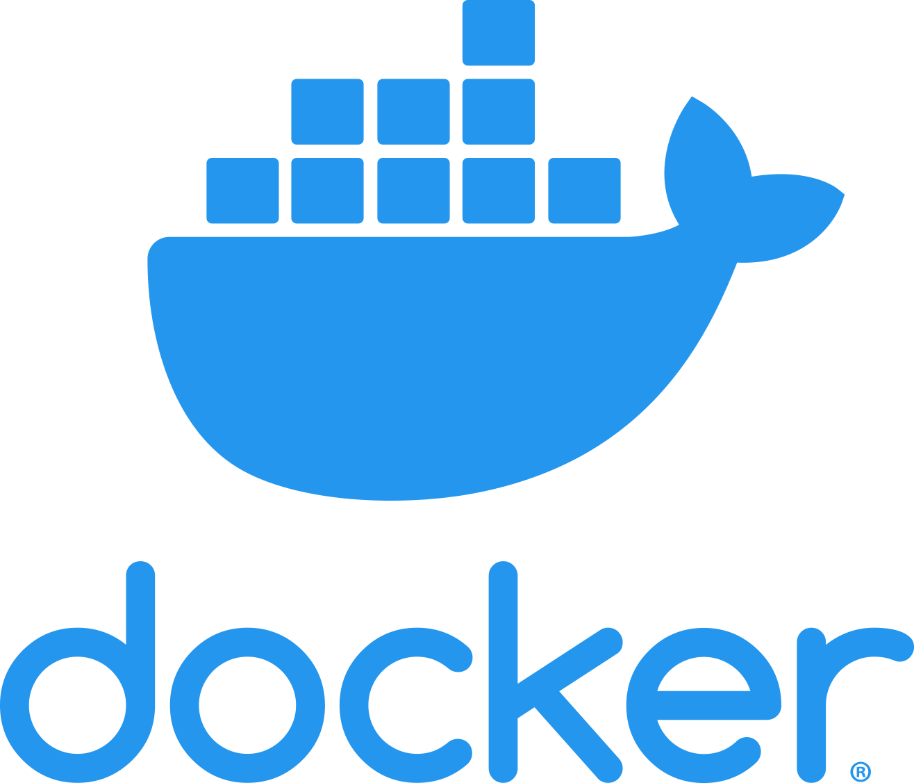
Docker Tutorial
Introduction to Docker
Notes:
https://www.simplilearn.com/tutorials/docker-tutorial/getting-started-with-docker

Slide 2
What is Docker ?
Docker is a software platform that employs OS virtualization, enabling IT organizations to swiftly generate, deploy, and execute applications within Docker containers.
These containers encapsulate all the necessary dependencies, including frameworks, libraries, and binaries, making them lightweight and self-sufficient.

Slide 3
Benefits
Docker facilitates effortless migration across various environments.
Within the DevOps life cycle, Docker excels primarily in deployment. During deployment, the priority is to ensure that the thoroughly tested code functions seamlessly in the production environment.
Having a container running the solution during code building and testing proves advantageous, as it allows you to validate your work in an environment identical to the production setup.

Slide 4
Difference Between Docker & Virtual Machines
Docker operates with a Docker engine layer.
Docker environments maintain low memory usage.
Docker consistently delivers high performance due to its single Docker engine.
Docker was purpose-built for portability, allowing solutions developed in a Docker container to work flawlessly regardless of the hosting environment.
Docker environments exhibit almost instantaneous startup providing significant advantage in bootup time.
Virtual Machines functions with Hypervisor Layer
Virtual machines consume a high amount of memory
Virtual machines tend to suffer when multiple instances are running on a server, leading to poorer performance.
Virtual machines rely heavily on the host operating system, causing portability issues.
Virtual machines have comparatively slow boot-up times

